Slide 1
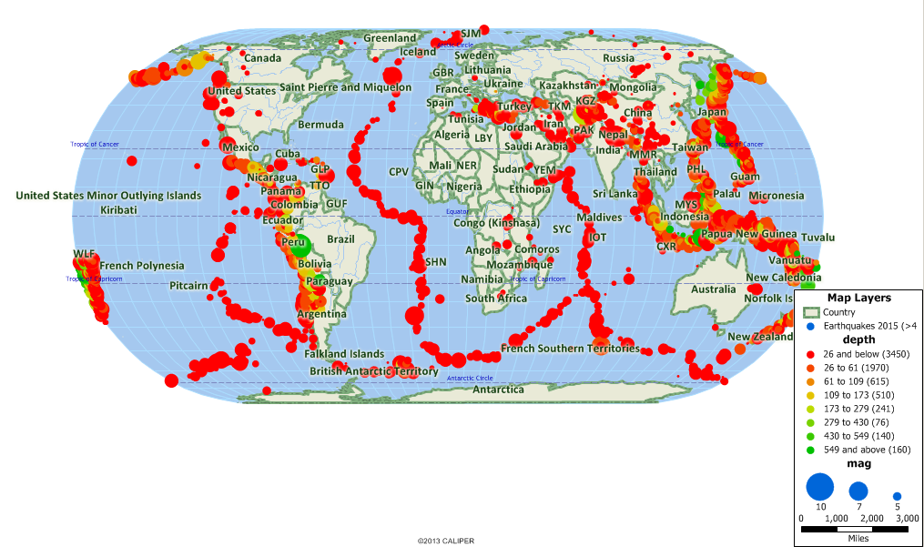
Earthquake Magnitudes and Location Predictions
Adrian Gonzalez
MET CS 677
Data Science with Python: Final Project

Slide 2
Introduction
This data contains information of earthquake coordinates, depth, time, date, and magnitude. There are 23,412 rows of worth of data ranging from the years 1965 to 2016.
The primary goal of my project is to predict where earthquakes will occur and what their magnitude and depth will be from the years 2011-2016 (which is my testing data), which will be trained on years 2006-2011.
Classifiers and regressors used are Decision Tree Classifiers, K Means Classifier, KNN Regression, and a Random Forest Classifier.

Slide 3
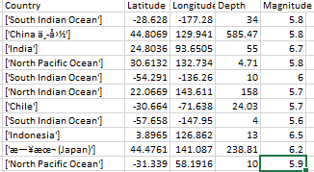
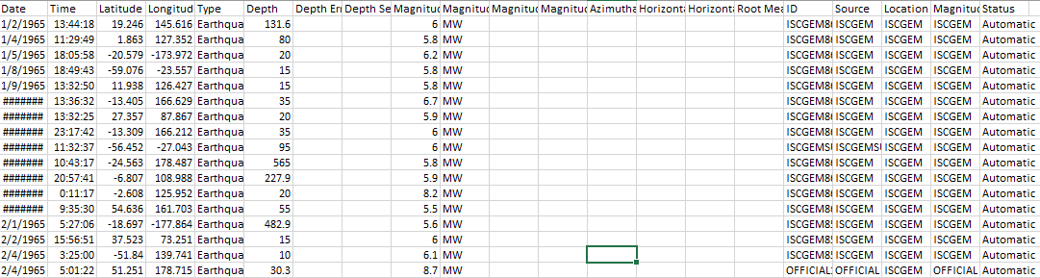
Filtering of Data
The python library “geopy” enables for the generation of labels, in this case being the name of countries or ocean, in accordance to Latitude and Longitude, however the process is rather timely (6 hours of waiting to assign labels to rows of data). These labels will be used as one of the features to train the classifiers and regressor's on.
Data with insignificant features
Filtered Data with significant features

Slide 4
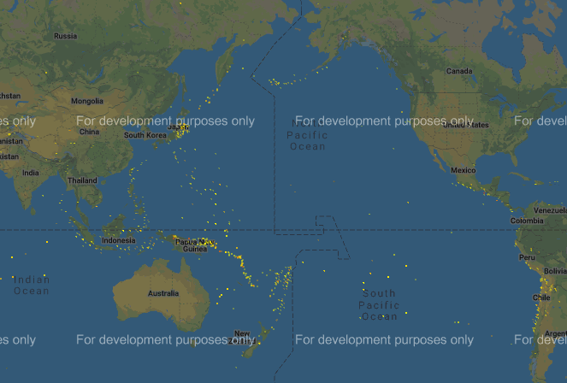
Visual Results of Prediction Model
Legend
>5.9 Medium Earthquake
5.9-6.9 Large Earthquake
>= 7.0 Major Earthquake

Slide 5
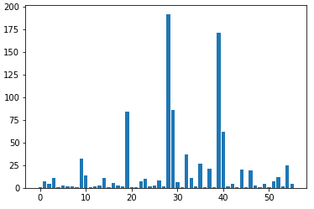
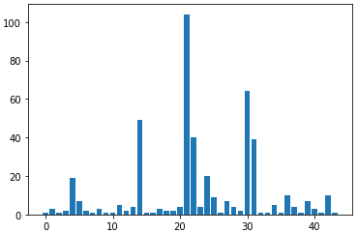
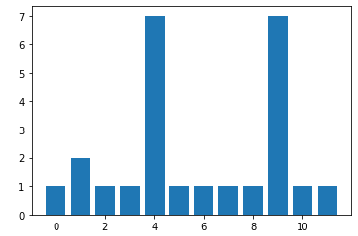
Analysis of Prediction Model
# of Occurrences of Medium Earthquakes
Per Country/Ocean
# of Occurrences of Large Earthquakes
Per Country/Ocean
# of Occurrences of Major Earthquakes
Per Country/Ocean
Label Encoders are used to keep the data organized.
The prediction model shows that major earthquakes are most likely to occur in Japan, Papua New Guinea, and New Zealand. Large earthquakes are to occur in the North Indian Ocean, South Indian Ocean, and Indonesia. This shows that large to major earthquakes are to occur in countries of Oceania, the North and South Indian Ocean, and Japan.

Slide 6
Classification Methods
Country/Labels
Magnitude
Classifier | R2 Score
K-Means | -638.17%
KNN | 20%
Decision Tree | 60.0 – 74.0%
RandomForest | 73.92%
Logistic Regression | -9.27%
Classifier | R2 Score
K-Means | -24.59%
KNN | -65.48%
Decision Tree | -74.50%
RandomForest | (-78%) – (-81%)
Logistic Regression | -96.04%

Slide 7
Regression Methods
Coordinates
Depth
Classifier | R2 Score
KNN Regressor | 9.16%
Decision Tree | N/A
RandomForest | 34.0% - 41.0%
Logistic Regression | N/A
Classifier | R2 Score
KNN Regressor | 34.0% - 41.0%
Decision Tree | 61.41%
RandomForest | 59.19%
Logistic Regression | N/A

Slide 8
Feature Selection Processes
Feature Contributions (vs all.)
Country/Labels
Magnitude
Coordinates
Feature Name | R2 Score
All Features | 59.84%
Lon/Lat | -80.26%
Depth | 70.00%
Magnitude | 65.73%
Feature Name | R2 Score
All Features | 66.86%
Lon/Lat | -58.35%
Depth | -90.70%
Countries | -64.04%
Feature Name | R2 Score
All Features | 38.16%
Countries | -228.75%
Depth | 21.19%
Magnitude | 37.49%
Depth
Feature Name | R2 Score
All Features | 16.62%
Lon/Lat | -47.59%
Countries | 14.76%
Magnitude | 76.07%

Slide 9
Conclusion
What I have learned from this project is that every classifier has its purpose and picking the right classifier in accordance to data is very important because it can change results drastically or very little.
I wish I could have improved the accuracy of the prediction model in terms of regression while maintaining variation of results in the model. Maybe more input or features could have increased the accuracy of the regression, however it would have been better if there was another regression method to help increase the accuracy of the prediction.

